Slide 1
MEASURING SEQUENCE ICONICITY
Student Name – Abhishek Sarangi
Student ID - 19301428
Stream – Data Science
Supervisor – Professor Tim Fernando

Slide 2
Student Name: Abhishek Sarangi | Student ID: 19301428 | Stream: Data Science | Supervisor Name: Tim Fernando
1. Research Question/Aim: MEASURING SEQUENCE ICONICITY.
2. Research Objectives Concerns temporal order. How the statement made by someone resembles the actual event. Measuring it to the highest degree of accuracy. What does it say about document type for example author , language and genre. |  | 3. Approach/Method to achieve objectives Gathering data from different datasets. Aim to gather data by talking to people. Proper labelling of data and classification. Running an algorithm on it to classify the results. Evaluation of results. Following a different approach if the model does not perform good.
4. Evaluation Running the trained model against various datasets and comparing the result with the actual dataset. Either making a logistic regression approach to mark the degree of accuracy by probability or doing a strict classification of classes. Cross validating with different approaches.
5. Contribution Propose a better approach to understand the temporal structure of languages. It can be used to understand how languages evolved. Propose a way to compare two different texts.

Slide 3
Motivation Statement
Student Name: Abhishek Sarangi | Student ID: 19301428 | Stream: Data Science | Supervisor Name: Tim Fernando
There is a deep relation between a sentence structure and the order of events. Knowing how a sentence structure dominates in different languages to describe the same order of events can explain the evolution of such languages. It can also help in developing sign languages and also in comparing texts from two different genres and the style of writing of the authors. There have several works related to making an annotator which can describe the relationship between temporal events and sentence structure . A better annotator will automat the process of describing the relationship between several order of events and a temporal structure . I am therefore motivated to work to make a better annotator to help in this research.

Slide 4
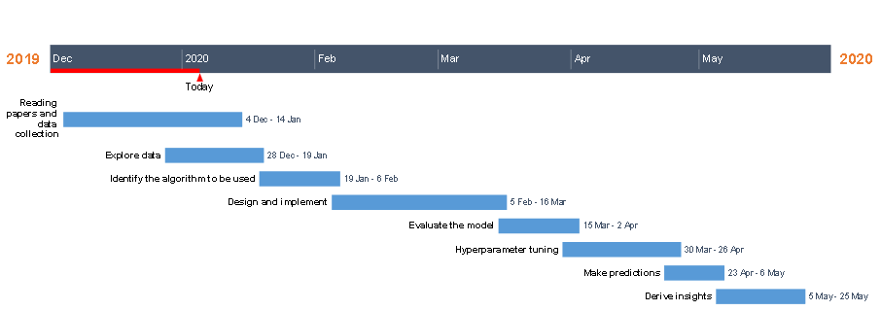
Gantt chart
Student Name: Abhishek Sarangi | Student ID: 19301428 | Stream: Data Science | Supervisor Name: Tim Fernando

Slide 5
Skills Required
Student Name: Abhishek Sarangi | Student ID: 19301428 | Stream: Data Science | Supervisor Name: Tim Fernando
Technical Skills
R/Python Programming
Statistics
Data Science
Machine Learning
Research skills
Proper understanding of data.
Good analysis of data.
Understanding the semantic of a sentence.
Good communication skills.

Slide 6
References
Student Name: Abhishek Sarangi | Student ID: 19301428 | Stream: Data Science | Supervisor Name: Tim Fernando
Allen, J. F. (1984). Towards a general theory of action andtime.Artificial intelligence, 23(2):123–154.
Bethard, S., Derczynski, L., Savova, G., Pustejovsky, J.,and Verhagen, M. (2015). Semeval-2015 task 6: Clinical tempeval. InSemEval@ NAACL-HLT, pages 806–814.
Bethard, S., Savova, G., Chen, W.-T., Derczynski, L.,Pustejovsky, J., and Verhagen, M. (2016). Semeval-2016 task 12: Clinical tempeval.Proceedings of Se-mEval, pages 1052–1062.
Styler IV, W. F., Bethard, S., Finan, S., Palmer, M., Prad-han, S., de Groen, P. C., Erickson, B., Miller, T., Lin,C., Savova, G., et al. (2014). Temporal annotation inthe clinical domain.Transactions of the Association forComputational Linguistics, 2:143–154.
Yoshikawa, K., Riedel, S., Asahara, M., and Matsumoto,Y. (2009). Jointly identifying temporal relations withmarkov logic. InProceedings of the Joint Conference ofthe 47th Annual Meeting of the ACL and the 4th Interna-tional Joint Conference on Natural Language Processingof the AFNLP: Volume 1-Volume 1, pages 405–413. As-sociation for Computational Linguistics.

Slide 7
References
Student Name: Abhishek Sarangi | Student ID: 19301428 | Stream: Data Science | Supervisor Name: Tim Fernando
Altenberg, Bengt1984Causal linking in spoken and written English.Studia Linguistica38, 20–69.Backhaus, Klaus, Bernd Erichson, Wul¤ Plinke, and Rolf Weiber2006Multivariate Analysemethoden. Eine anwendungsorientierte Einfu ̈hrung. Ber-lin: Springer. [11th. edition].
Clark, Eve V.1971On the acquisition of the meaning ofafterandbefore.Journal of VerbalLearning and Verbal Behavior10, 266–75.1973How children describe time and order. In Charles A. Ferguson and Dan I.Slobin (eds.),Studies of Child Language Development. New York: Holt,Rinehart and Winston, 585–606.
MacDonald, Maryellen C., Neal J. Pearlmutter, and Mark S. Seidenberg1994The lexical nature of syntactic ambiguity resolution.Psychological Review191, 676–703.
Thompson, Sandra A.1985Grammar and written discourse. Initial and final purpose clauses in English.In Talmy Givo ́n (ed.),Quantified Studies in Discourse.Special issue ofText5, 55–84.
Verstraete, Jean-Christophe2004Initial and final position of adverbial clauses in English: the constructionalbasis of the discoursive and syntactic di¤erences.Linguistics42, 819–853.

Slide 8
Ethics Statement
Student Name: Abhishek Sarangi | Student ID: 19301428 | Stream: Data Science | Supervisor Name: Tim Fernando
No, I would not need to make an ethics application.

